Slide 1
IPL TEAMS APP

Slide 2
Introduction
Project Title: IPL Teams Single Page Application (SPA)
Purpose: A web-based platform that allows users to explore IPL teams, view team details, and access player information dynamically.
Framework Used: Developed using Angular for efficient front-end development.
Main Features:
Seamless navigation without page reloads.
Interactive UI with Bootstrap styling.
Dynamic data handling using Angular services and RxJS.
Team and player details with images, captains, and descriptions.
Search and filtering functionality using Angular Pipes.
Admin login system to manage contact form submissions.
LocalStorage integration for storing user inquiries and responses.

Slide 3
Project Overview
What is this project about?
This IPL Teams SPA is built to provide an engaging platform where users can explore IPL teams, view player details, and access key team information dynamically.
Key Functionalities:
Display IPL teams and players dynamically.
Provide detailed player profiles with images, age, and descriptions.
Search and filter teams and players using Angular Pipes.
Admin login system for managing contact form submissions.
LocalStorage integration to store and retrieve user inquiries.
Seamless navigation with Angular routing.
Why Angular?
Component-based architecture for better code maintainability.
Efficient routing and state management for a smooth user experience.
Built-in features like Forms, Directives, and Dependency Injection for enhanced functionality.

Slide 4
Technology Stack
Frontend: Angular, TypeScript
Styling: Bootstrap, CSS
Data Handling: Angular Services & LocalStorage
Routing: Angular Router for seamless navigation
State Management: Observables and Angular Services

Slide 5
Project Architecture
Component Structure:
Modular and reusable components for managing teams, players, and match details efficiently.
Routing Implementation:
Configured using app-routing.module.ts to enable smooth navigation between Home, Teams, About, and Contact pages.
Services & Observables:
Team and player data are managed through Angular Services with RxJS Observables for dynamic updates.
Data Storage:
Utilizes Local Storage to persist user interactions, such as favorite teams or submitted contact form responses.

Slide 6
Features
Teams Listing Page:
Displays all IPL teams dynamically with key details.
Team Details Page:
Shows detailed information about each team, including captains, players, and team history.
Player Profiles:
Displays individual player details, including images, age, and a brief description.
Admin Login:
Allows admin users to log in and access submitted contact forms.
Ensures secure authentication before viewing form responses.
Search and Filter System:
Users can search for teams and filter results using Angular Pipes for a better browsing experience.
Responsive Design:
Fully optimized for mobile, tablet, and desktop for a seamless user experience.

Slide 7
Project Workflow
User Flow for IPL Teams Website:
User lands on the Home Page → Sees all available IPL teams.
Clicks on a team → Navigates to the Team Details Page.
Explores team details → Views captain, players, and team history.
Searches for a specific team or player → Uses search and filter functionality.
Navigates to the About Page → Sees key details about the IPL and captains.
Contacts the admin → Fills out the contact form for inquiries.
Admin logs in → Views submitted contact forms securely.

Slide 8
Code Implementation
Component-Based Development in IPL Teams Website
Each section (Home, Teams, About, Contact) is built as a standalone Angular component.
Uses @Input() and @Output() for efficient data sharing between components.
Routing and Navigation
Configured using app-routing.module.ts for seamless navigation across pages.
Uses RouterModule and ActivatedRoute to dynamically fetch and display team details.
Services & Observables
Implements Angular Services to manage team and player data efficiently.
Uses RxJS Observables to handle real-time updates for search and filtering.
Local Storage Usage
Stores contact form submissions and admin login status using Local Storage.
Ensures data persistence even after page refresh for better user experience.

Slide 9
Project Achievements
Development Summary of IPL Teams Angular Website
Built a fully functional, responsive, and interactive Single Page Application (SPA) using Angular.
Implemented core Angular concepts like Components, Services, Routing, and Observables for efficient data management.
Future Enhancements:
Adding a dedicated section for IPL match schedules and live scores.
Introducing an admin panel to manage teams and player details.
Enabling a user review and rating system for teams and players.

Slide 10
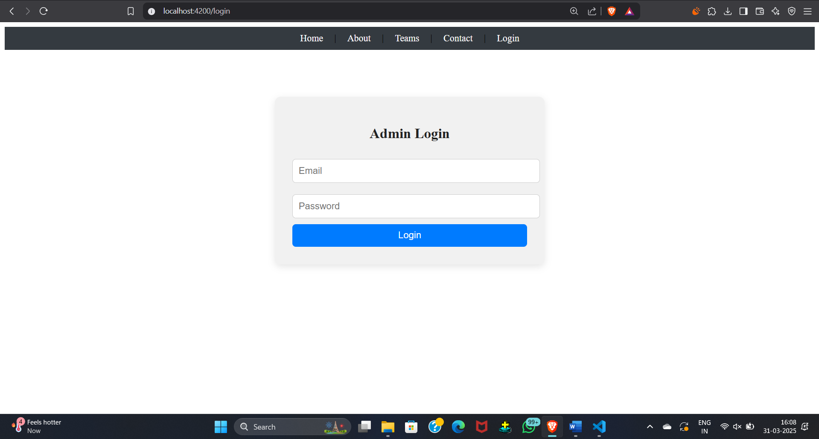
UI Screenshots
LOGIN

Slide 11
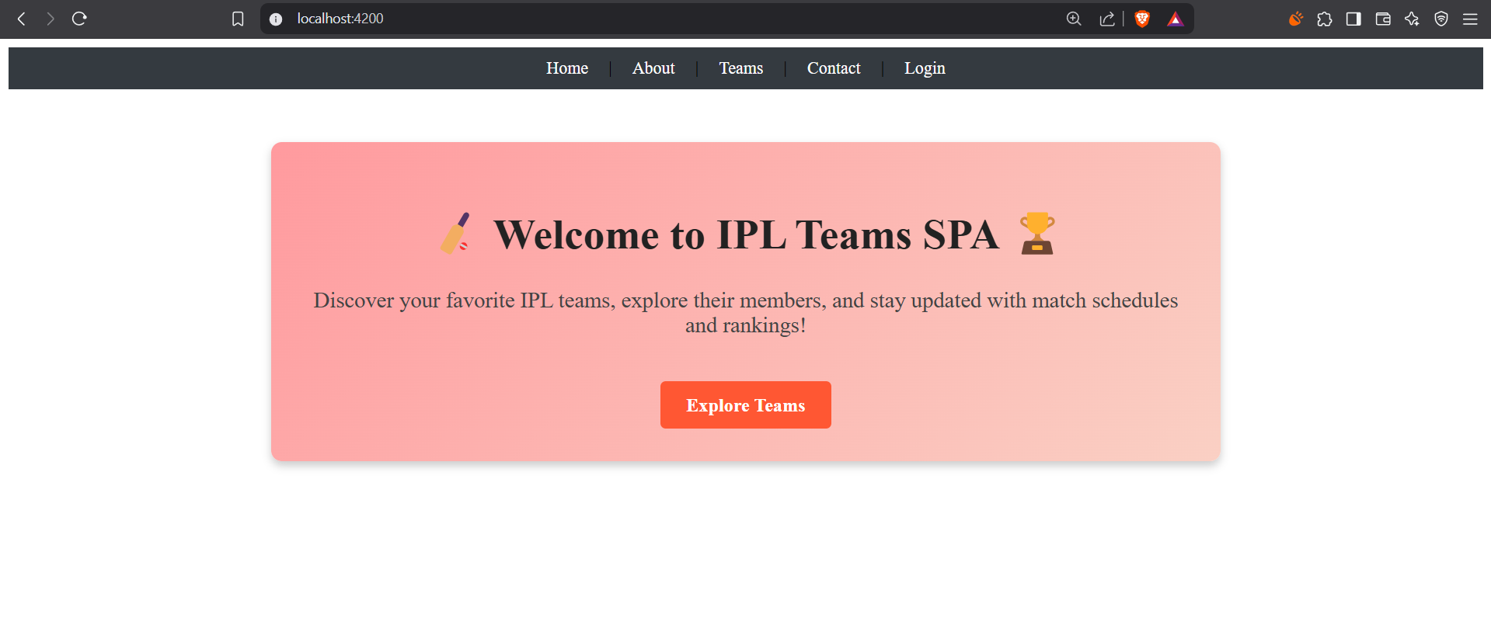
Home Page

Slide 12
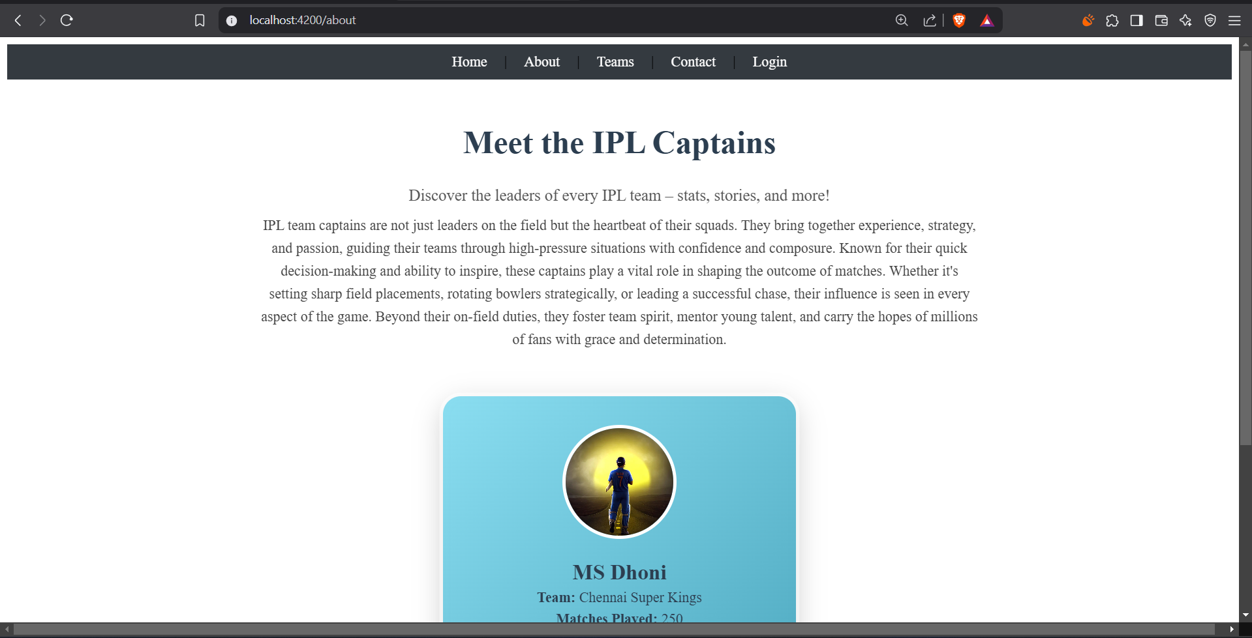
About page

Slide 13
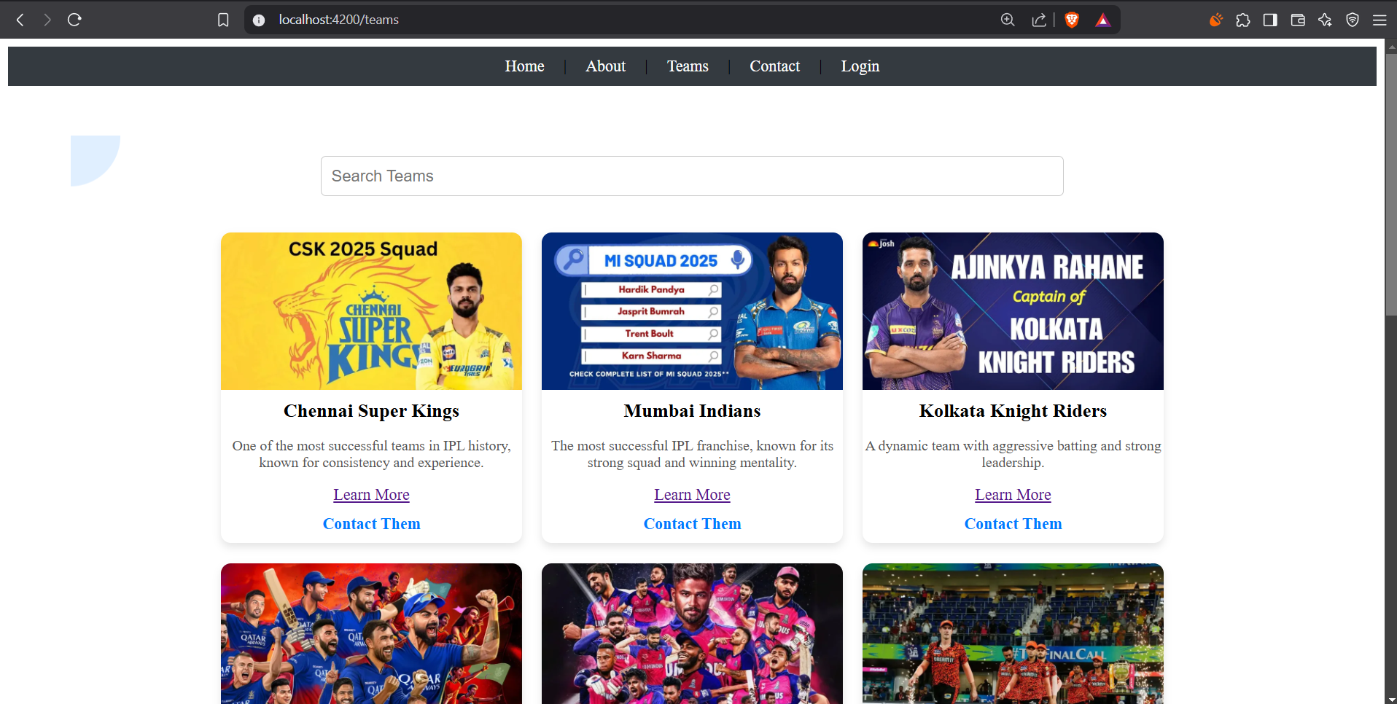
TEAMS PAGE

Slide 14
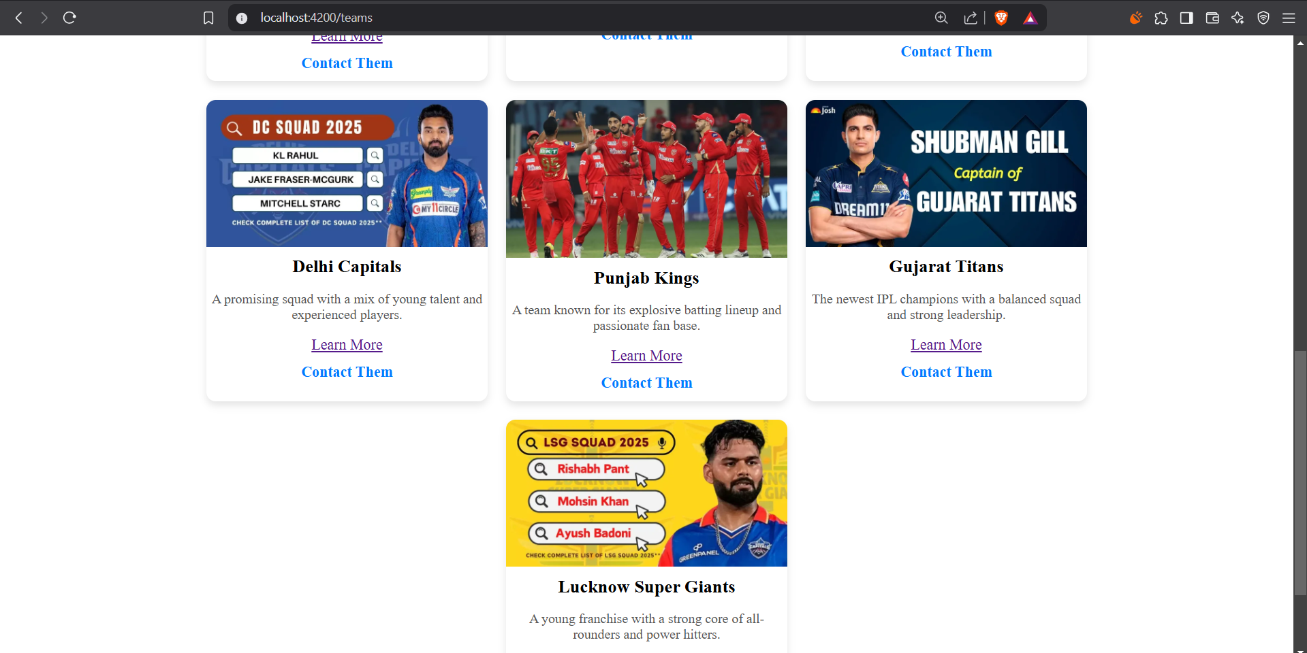

Slide 15
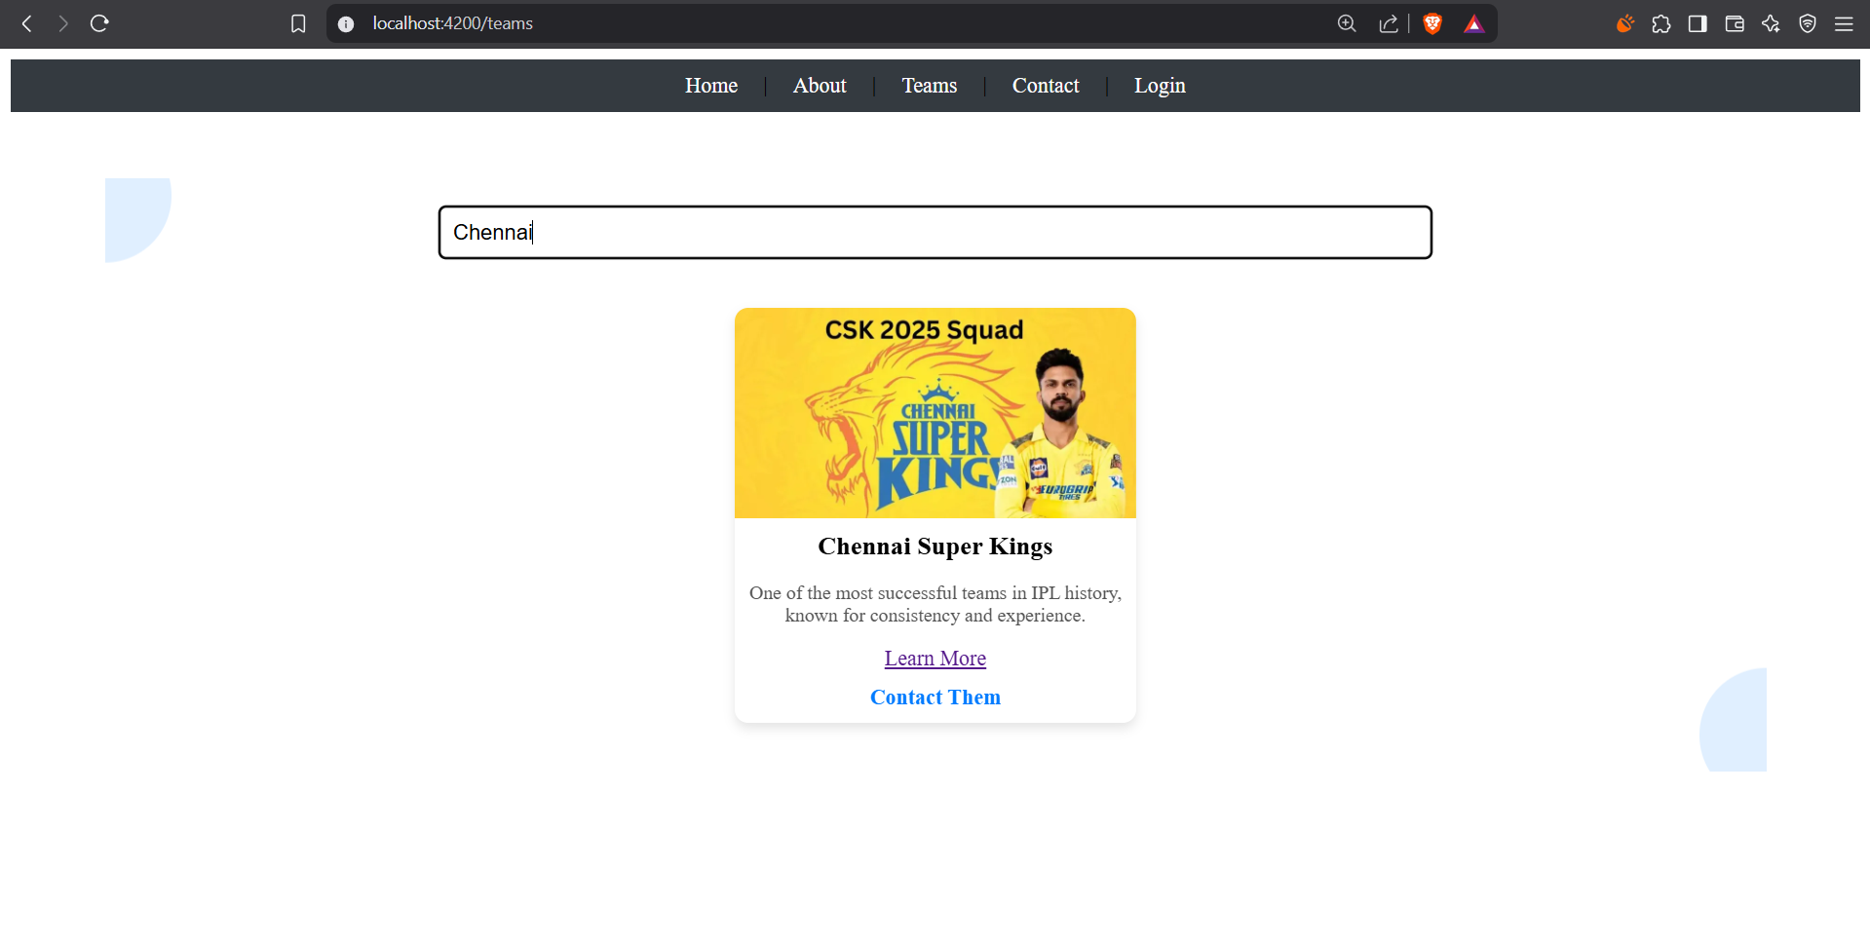
SEARCHING PAGE :

Slide 16
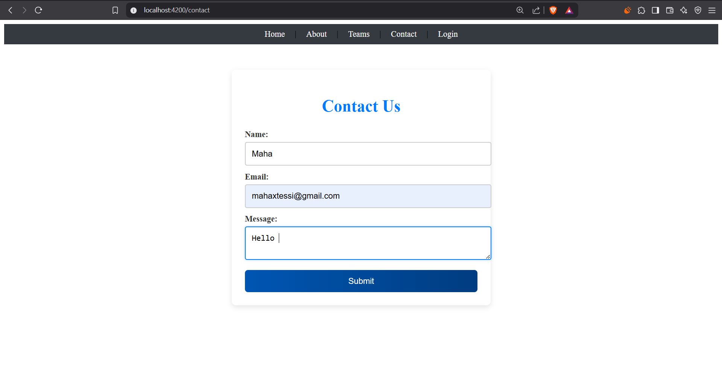
Contact us page :

Slide 17
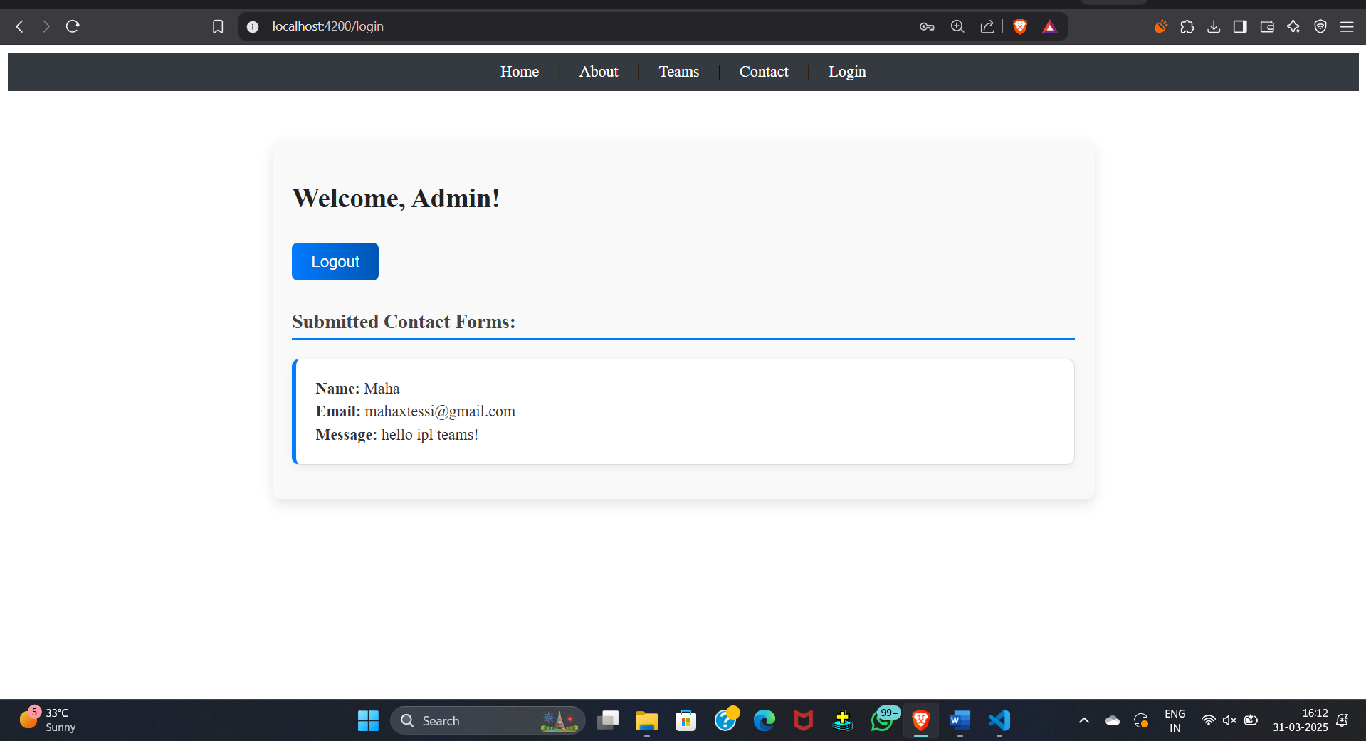
ENQUIRY PAGE :

